Slide 1




3
Formula in Excel
Prepared By :
Said Fawzy
Manager of Information Center
Tendering Department
Arab Contractors

Slide 2

1
What is Formula ?
2
Controlling calculations
3
Cell References
4
Calculating a Percentage of a Number

Slide 3
1
What is Formula ?

Slide 4


Slide 5
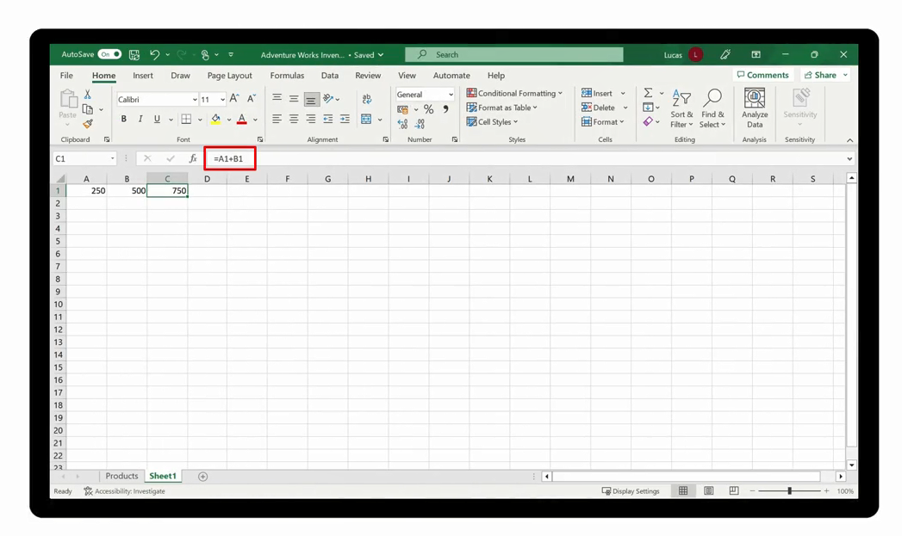
Formula begins with =

Slide 6
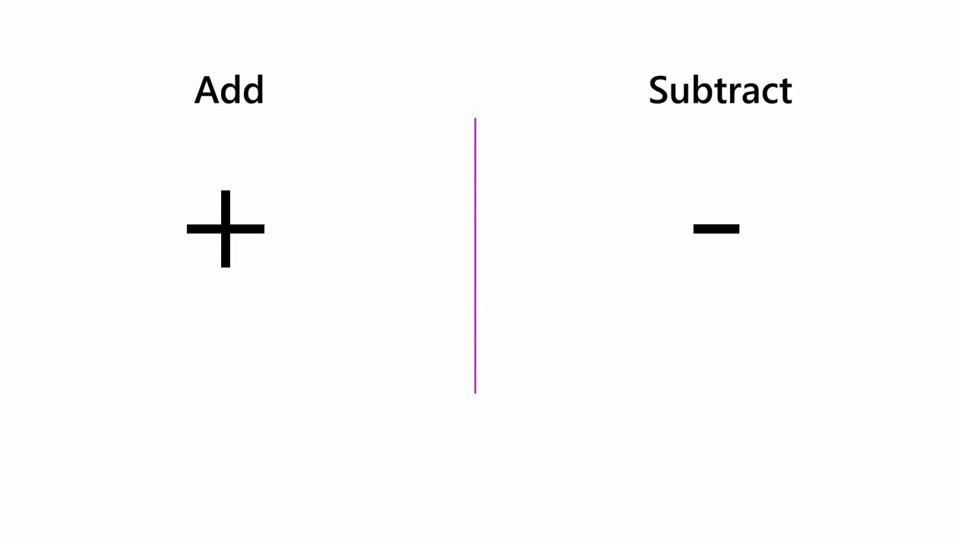

Slide 7
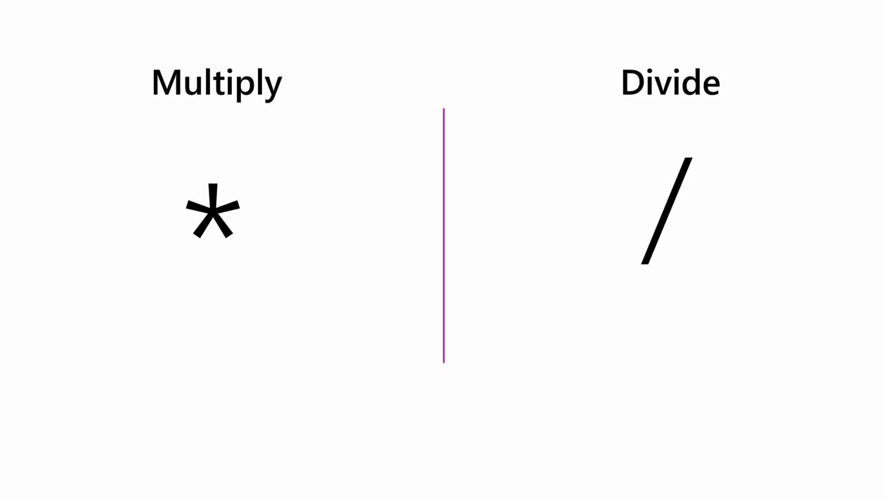

Slide 8
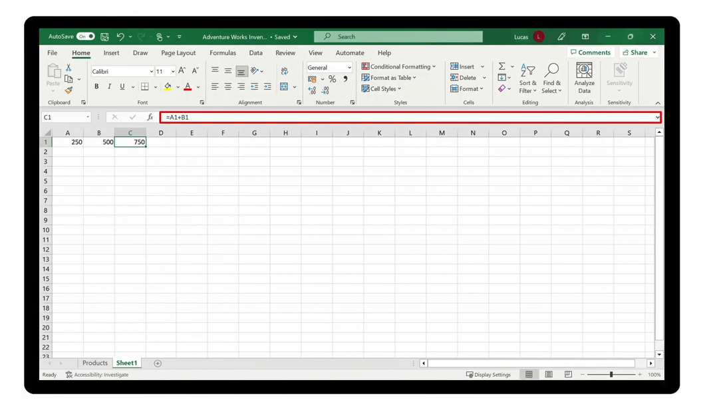
The formula
The Result

Slide 9
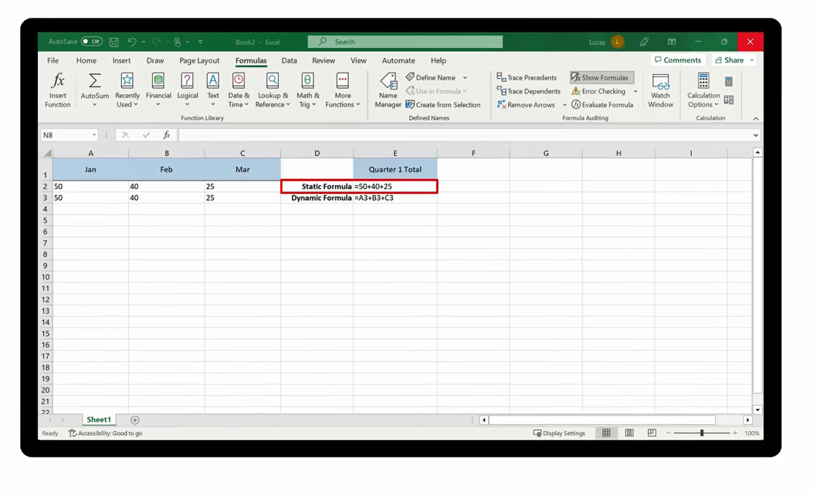
Static Formula
Always generate the same result

Slide 10
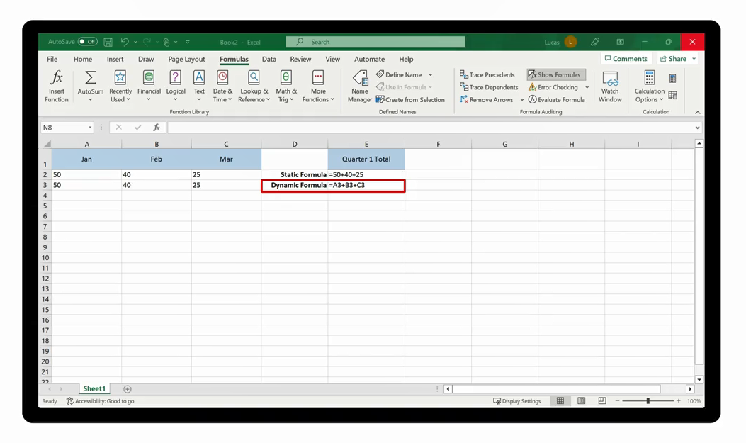
Dynamic-Based Formula
Always Uses the current value in the cell

Slide 11
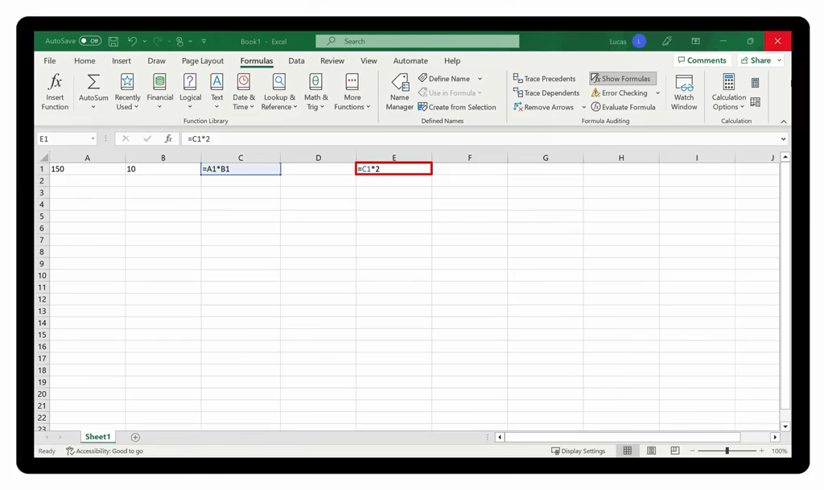
Chain of Calculation

Slide 12
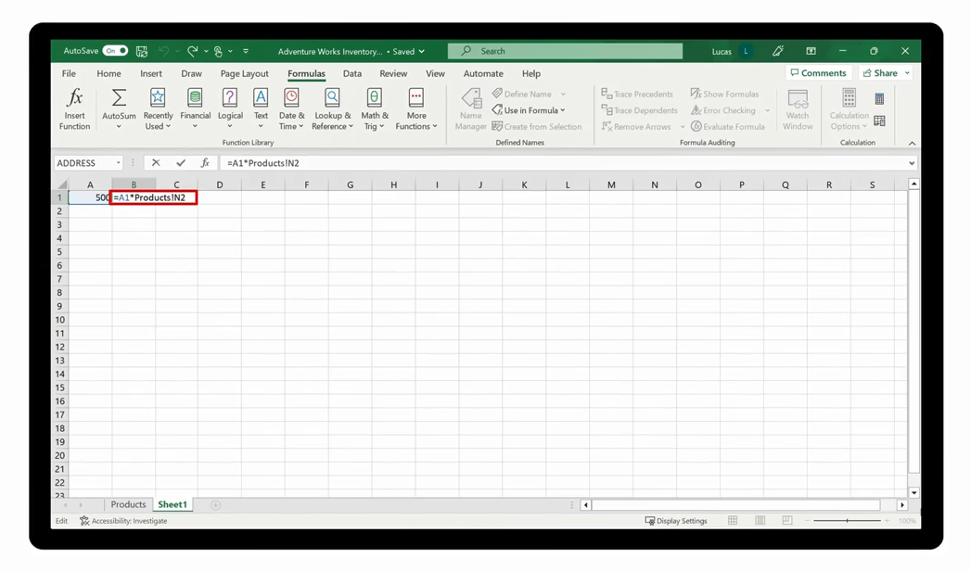
Referencing a cell in another sheet
Products!N2

Slide 13

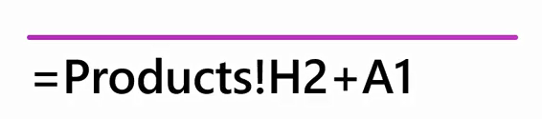

Slide 14

Demo 3 A
Formula in Excel

Slide 15
Question 3-1
You are creating a formula in a worksheet called Summary. This formula also includes a reference to cell H2 in a worksheet called Products. How will this reference appear in the formula?
A. Products!H2
B. ProductsH2
C. !H2

Slide 16

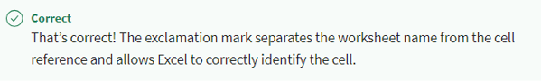
Question 3-1
You are creating a formula in a worksheet called Summary. This formula also includes a reference to cell H2 in a worksheet called Products. How will this reference appear in the formula?
A. Products!H2
B. ProductsH2
C. !H2
Explanation

Slide 17
2
Controlling calculations

Slide 18


Slide 19


Slide 20
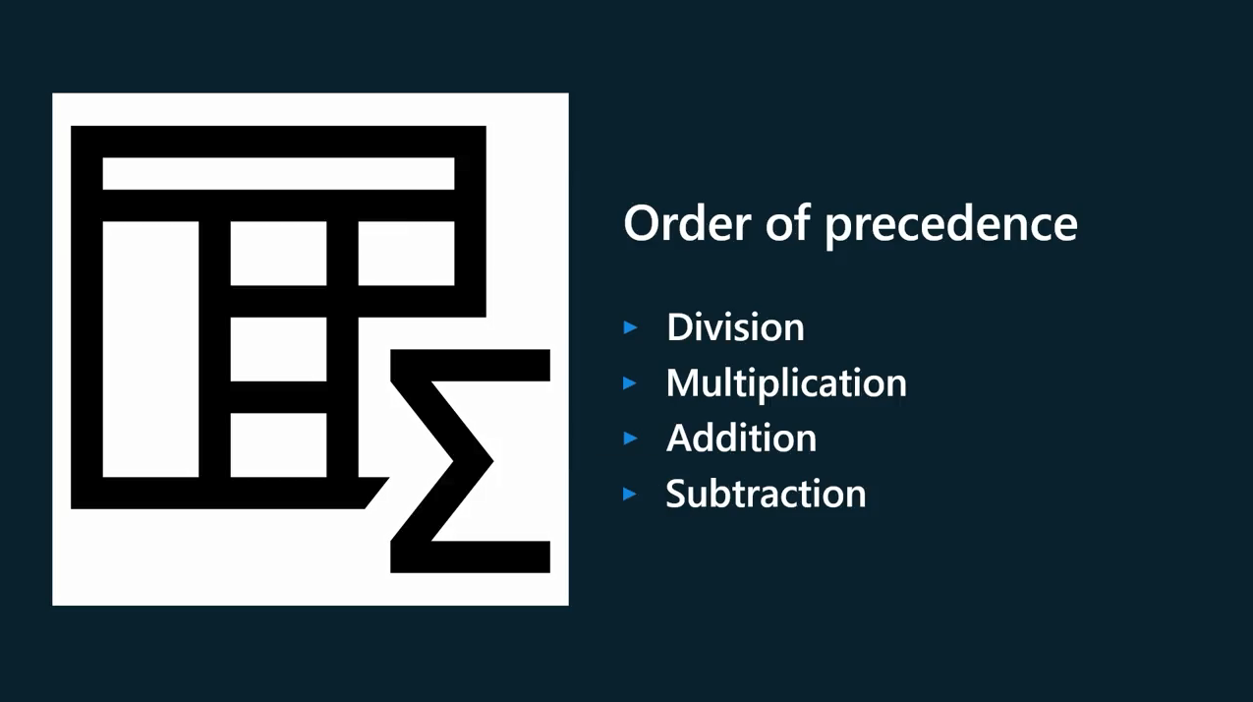

Slide 21
Order of precedence in calculations
Name | Symbol | Example
Exponent | ^ | 10^2=100
Multiplication | * | 10*2=20
Division | / | 10/2=5
Addition | + | 10+2=12
Subtraction | - | 10-2=8
Equivalence | = | 10 = 10
Greater than | > | 10>2
Less than | < | 2<10

Slide 22
The following formula is processed from left to right:
=A4+C10-D15

Slide 23
However, the following formula would not be processed from left to right:
=B4-D10/H9

Slide 24


Slide 25
Using Brackets to Control a Calculation
Adding brackets to the calculation allows you to override the Order of Precedence and direct Excel to process the formula in a specific order.
=(B4-D10)/H9

Slide 26

14

Slide 27
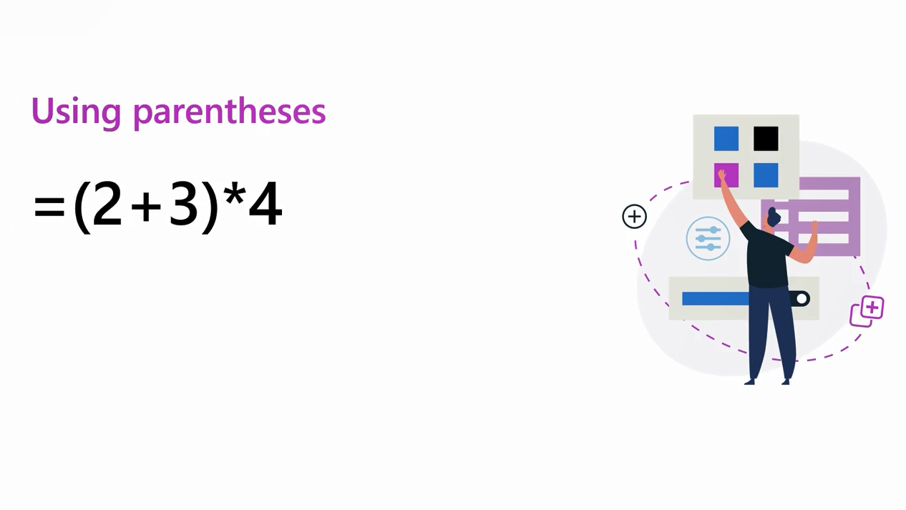
20

Slide 28

=((30+20)-(5*2))/2
(
50
-
10
)
/2
40
/2
20

Slide 29
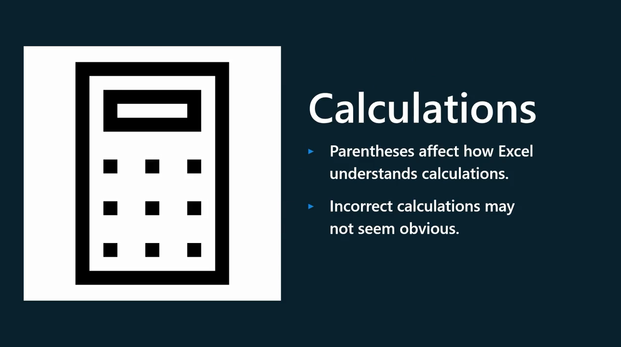

Slide 30
3
Cell References

Slide 31


Slide 32
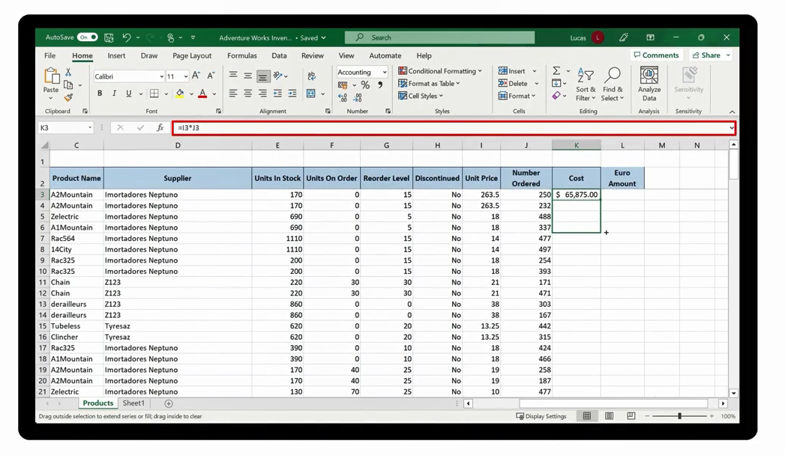

Slide 33
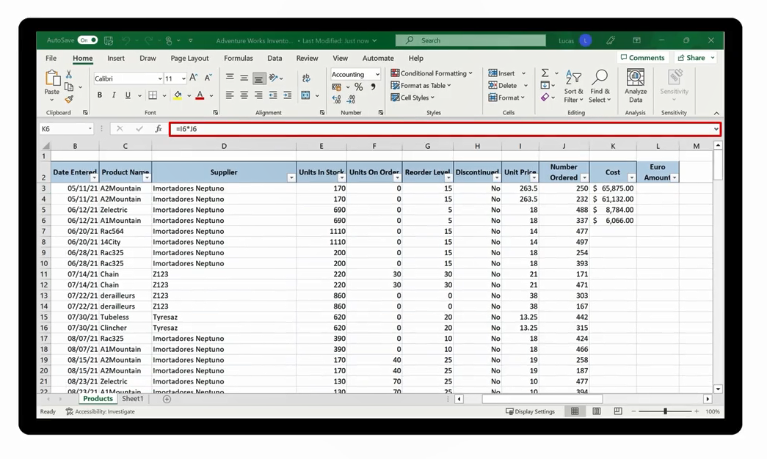

Slide 34


Slide 35
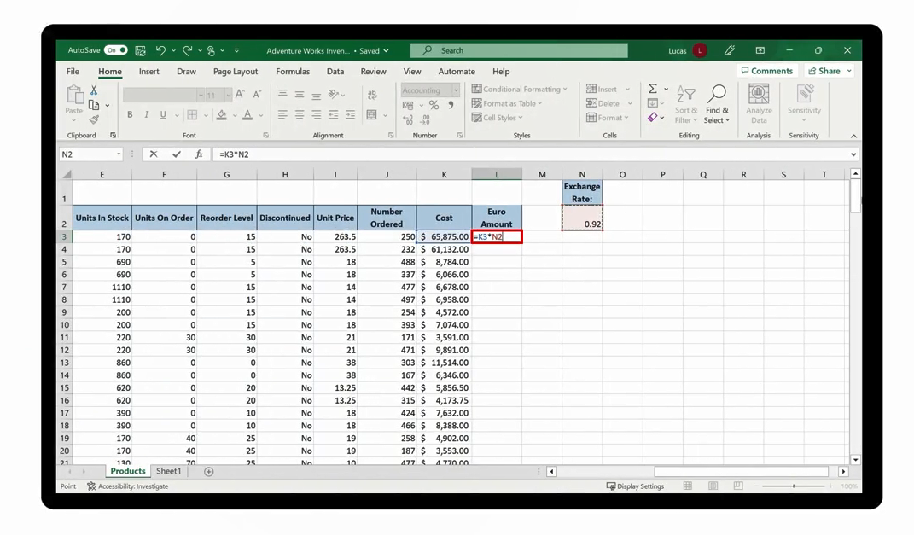

Slide 36


Slide 37
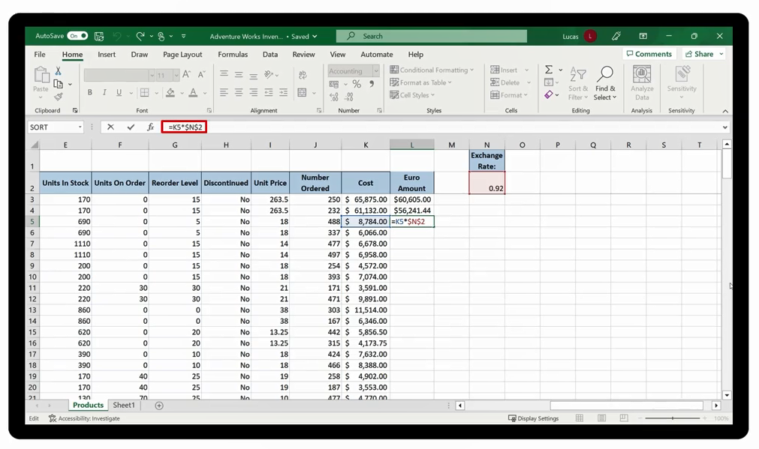

Slide 38
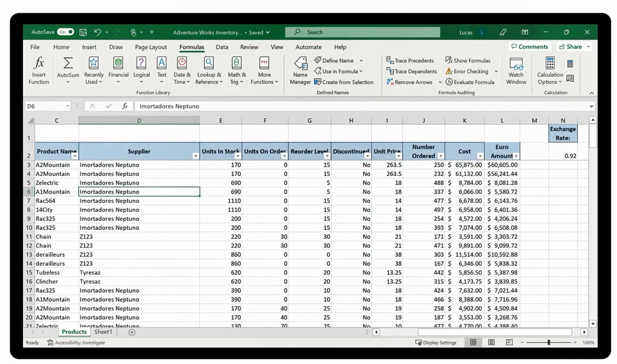
Excel will also recalculate and update all formula results when a file is opened.

Slide 39
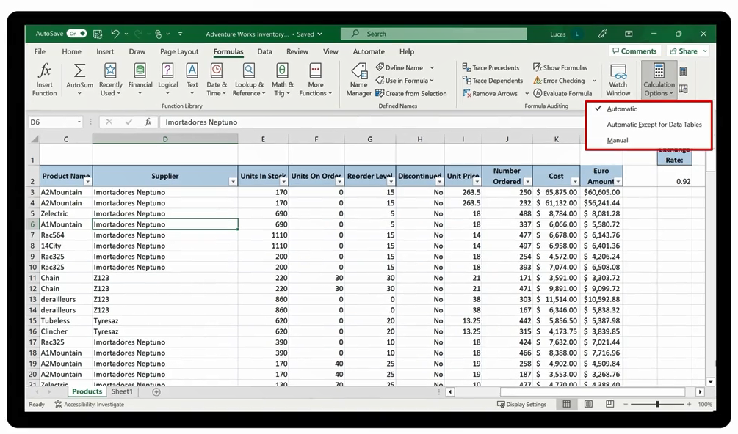
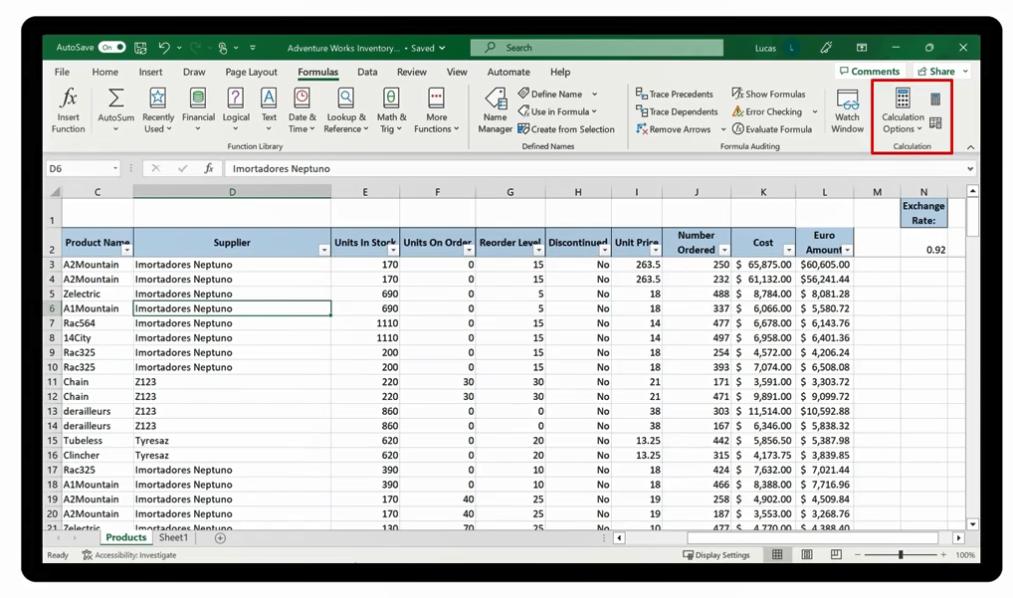
Change the Calculation Mode

Slide 40
Question 3-2
You are creating a calculation in your worksheet. You want Excel to subtract a figure held in C5 from a total held in H2 and then for the result to be divided by four. Which formula will calculate this correctly?
=C5-H2/4
=H2-C5/4
=(H2-C5)/4

Slide 41
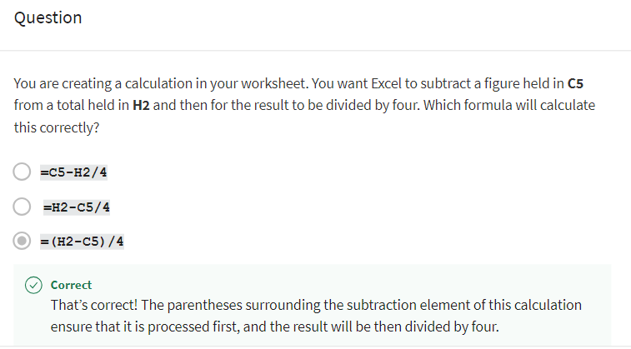
Question 3-2
Explanation

Slide 42
Demo 3 B
Controlling calculations

Slide 43
Question 3-3
Question 3-3
A Microsoft Excel worksheet contains the following formula:
=A2*B3/C2+D4
Which operator in this calculation will Excel process first?
Division
Multiplication
Addition

Slide 44
Question 3-3
A Microsoft Excel worksheet contains the following formula:
=A2*B3/C2+D4
Which operator in this calculation will Excel process first?
Division
Multiplication
Addition
The multiplication and division operators have greater priority than the addition, though they are equal. Excel will process them first and work left to right in the calculation.

Slide 45
Calculating a Percentage of a Number
4

Slide 46
=500/100*10
50
=A2/100*10

Slide 47
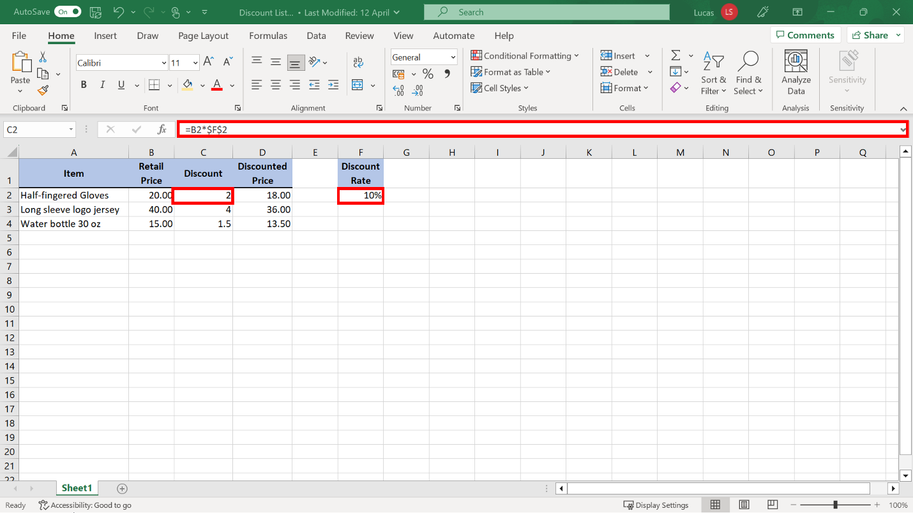

Slide 48
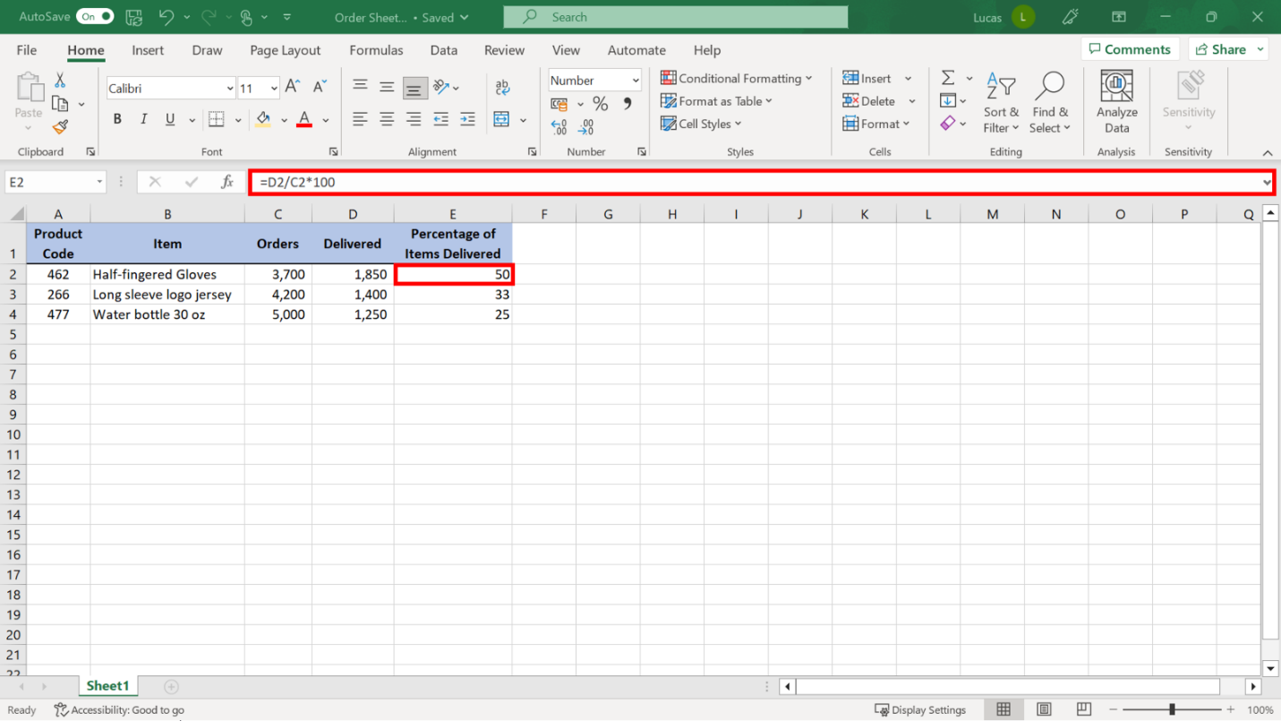
Expressing one number as a percentage of another
Calculation Generating a Standard Number Result

Slide 49
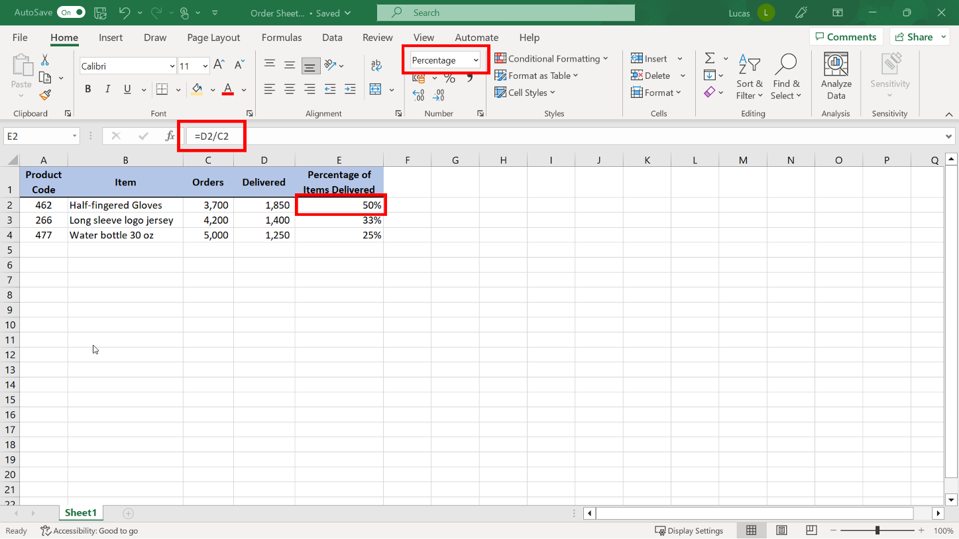
Expressing one number as a percentage of another
Calculation Generating a Percentage Figure Result

Slide 50
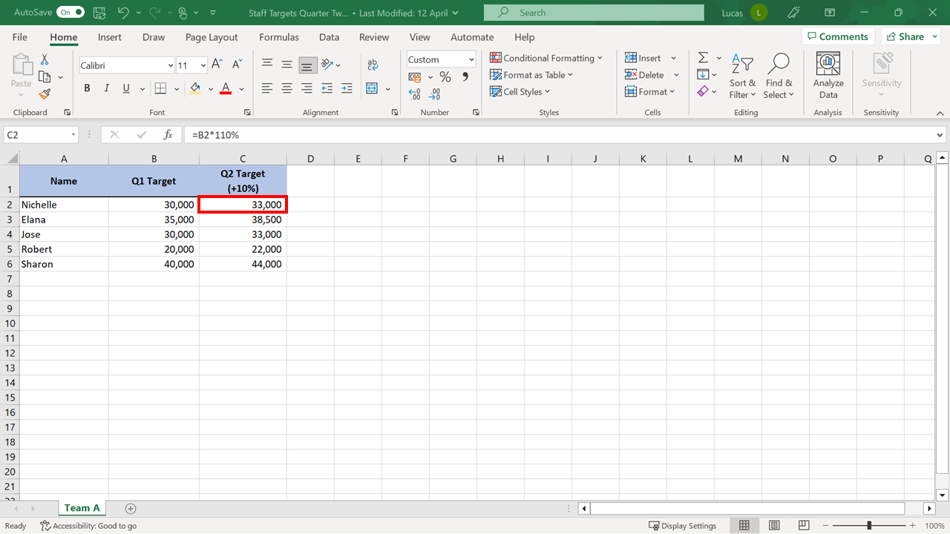
Increasing or Decreasing a Number by a Percentage

Slide 51
Calculating Percentage Difference in Excel
=(May Sales – April Sales)/April Sales
=(D5-C5)/C5

Slide 52
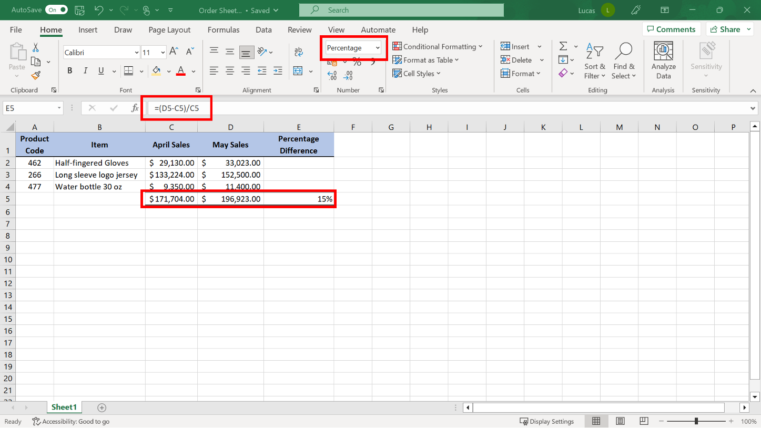
Calculating Percentage Difference in Excel

Slide 53

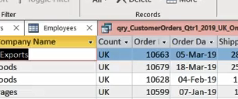
Exercise 3: Calculating profit and margin.

Slide 54

Exercise Questions
Question 1
When you created the calculation in cell G4, you were able to use the double-click shortcut to Autofill copies of the formula into the cells underneath. What data did Excel use as a visual reference to determine when to stop copying the formula?
The block of information in row 201.
The block of information in column F.
The block of information in column K.

Slide 55
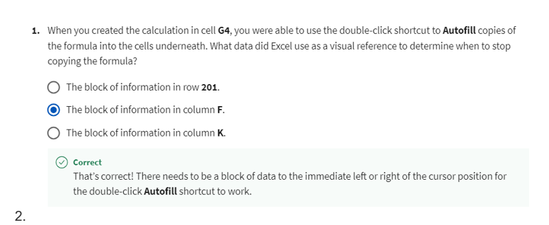
Explanation

Slide 56
Exercise Questions
Question 2
In cell H4 you created a formula that worked out the total shipping cost. Cell P1 contained the $5 per item shipping charge. Column F contained multiple rows of entries. Which of the following was the correct syntax for the formula to ensure that it copied correctly when you used the Autofill shortcut?
=F4*P1
=F4*$P$1
=$F$4*P1

Slide 57
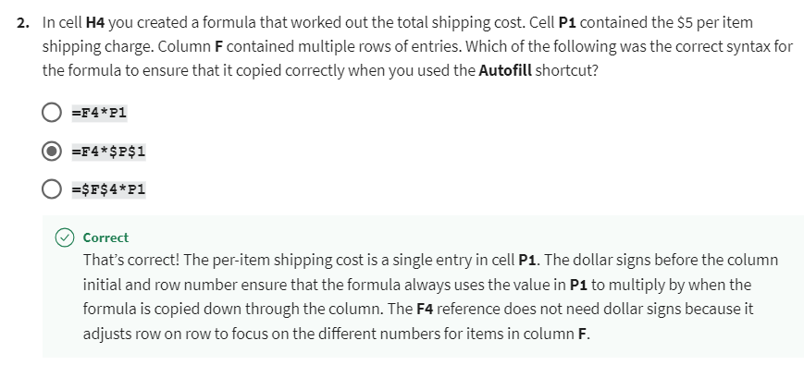
Explanation

Slide 58
Exercise Questions
Question 3
In cell J4, you created a formula with parentheses to set a new retail price by adding numbers together and working out a percentage increase. What result did you get for the calculation?
$333.24
$222.16
$224.66

Slide 59
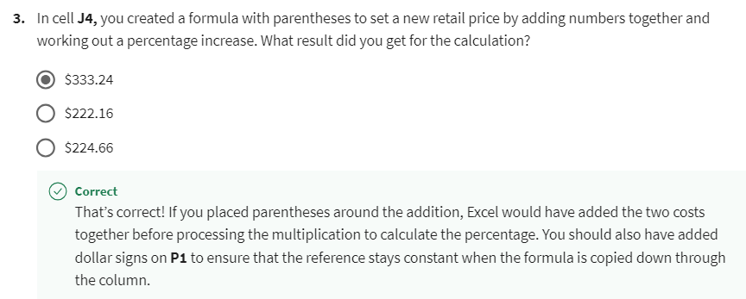
Explanation

Slide 60


Slide 61

3
Question 1
You are creating a formula in cell C2 in your worksheet. The calculation only needs to appear in cell C2. You have typed the following formulas:
A3*D15/45*F17
However, there is an error in the syntax of this formula. What part of the formula is missing?
Dollar Signs
An Equals Sign
Parentheses

Slide 62
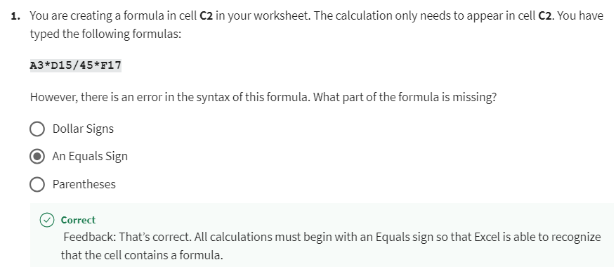
3
Explanation

Slide 63
3
Question 2
Cell D2 of your worksheet contains the weekly sales total. Cell D7 contains the overall monthly sales. You need cell E2 to show what percentage the week one total is of the overall monthly total. You’ve already applied the percentage format to E2. Which of the following options is the correct syntax for the formula?
=D7/D2
=D2/D7
=D2/D7*100

Slide 64
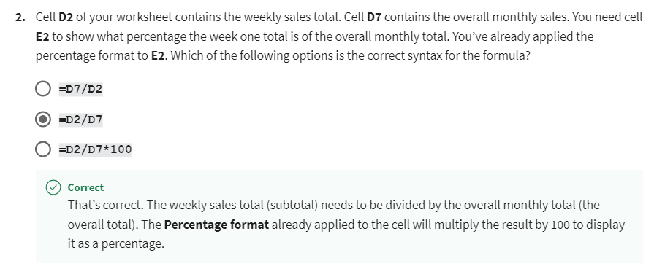
3
Explanation

Slide 65
3
Question 3
True or False: When Excel processes the following formula, it will first multiply cell A1 by cell C3 before it processes the addition.
=(B15+D45)-(A1*C3)
True
False

Slide 66
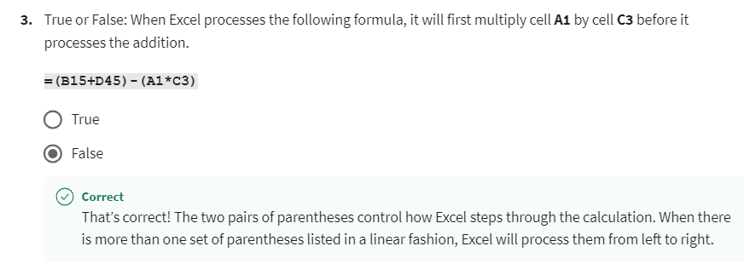
3
Explanation

Slide 67
3
Question 4
You have created the following formula in your worksheet:
=D4+$C$6-E4+F6
You use the Autofill feature to copy the formula down the column. Which of the cell references will update with new row numbers?
C6, E4, F6
D4, C6, E4
D4, E4, F6

Slide 68
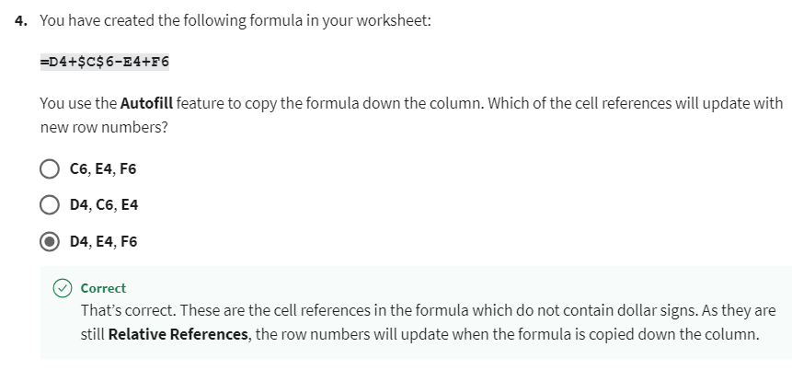
3
Explanation

Slide 69
3
Question 5
What mathematical sign does Excel process last when calculating the results of the following formula?
=D4+C3/N5*B3
The plus sign.
The Division sign.
The Multiplication sign.

Slide 70
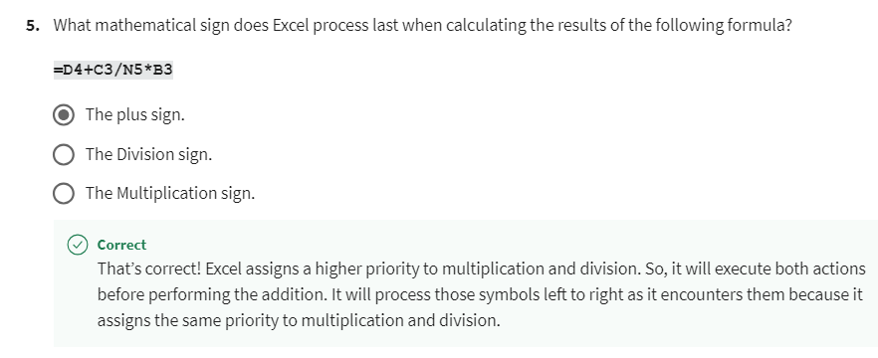
3
Explanation

Slide 71


